Slide 1

Data Mining
Text Classification with Tensorflow
201635838 이예지

Slide 2
Data Mining
Final Presentation
CONTENTS
Implementation 1
Implementation 2
Implementation 3
Implementation 4
Conclusion

Slide 3
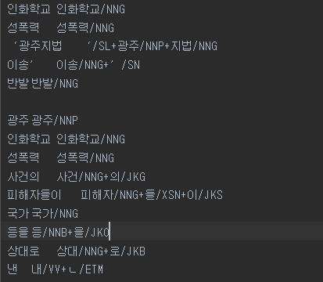
Data Mining
Implementation 1
Goal: Construct whole Feature set
Input
News data with Morphological analysis
(POS)child_1.txt

Slide 4
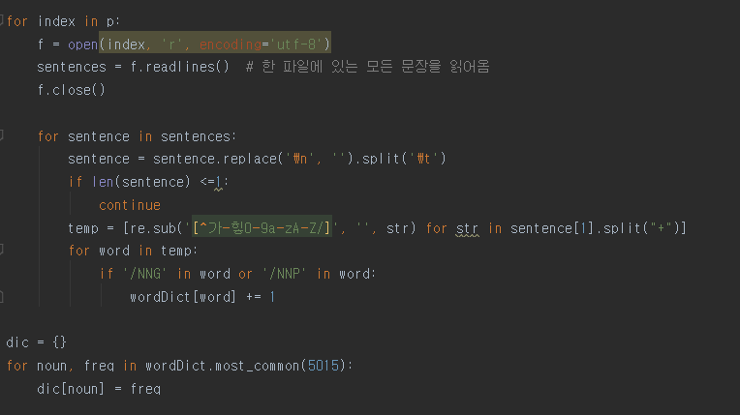
Data Mining
Implementation 1
Goal: Construct whole Feature set
regular expression
most common 5015
Key code

Slide 5
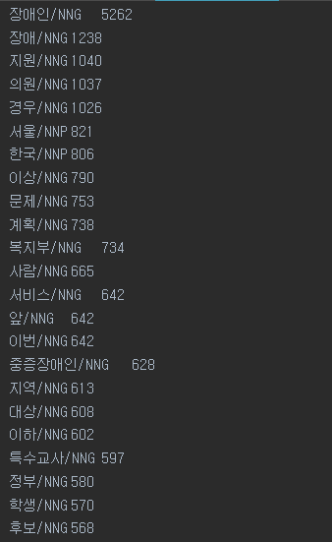
Data Mining
Implementation 1
Goal: Construct whole Feature set
output
Extract words with high frequency only from folders inside Input_Data
Output.txt

Slide 6
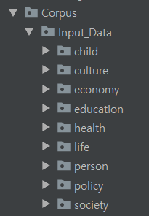
Data Mining
Implementation 2
Goal: Document(Vector) Representation with TF-IDF
Input
Input_Data in Corpus folder

Slide 7
Data Mining
Implementation 2
Goal: Document(Vector) Representation with TF-IDF
Key code
Make Term-Frequency
Notes:
평가데이터로TF-IDFfeature를만들때는반드시학습데이터에서이전에결정한5000개의명사류형태소에대하여TF-IDF값을계산하는것이다.
▪뿐만아니라,학습데이터에서사용한5000개명사류형태소에대한IDF값을평가데이터에서사용하여TF-IDF값을계산한다.
▪즉,하나의문서에대한TF-IDF벡터를만들때는1)학습과정에서결정한5000개명사류형태소가현재문서에서각각몇번씩나타났는지빈도수를계산(Term-Frequency)2) 현재문서에서5000개의명사류형태소에대한IDF값은학습과정에서사용한각형태소의IDF값을그대로사용한다.(IDF)3)1), 2)에서TF, IDF값각각을구했으니,이두값을곱하고벡터전체에대한정규화를하면이때나온벡터가최종적인평가데이터의한문서에대한TF-IDF 벡터가됨.

Slide 8
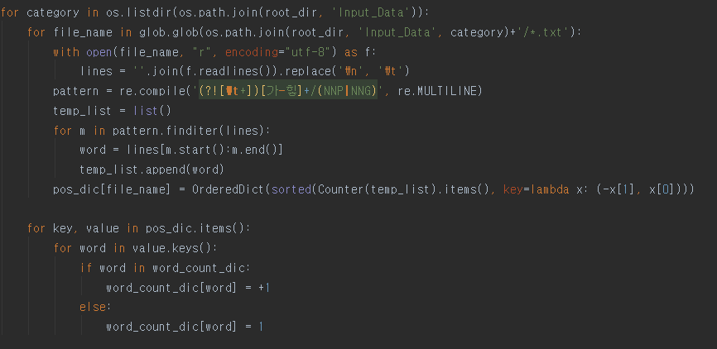
Data Mining
Implementation 2
Goal: Document(Vector) Representation with TF-IDF
Key code
Make whole dictionary
Notes:
평가데이터로TF-IDFfeature를만들때는반드시학습데이터에서이전에결정한5000개의명사류형태소에대하여TF-IDF값을계산하는것이다.
▪뿐만아니라,학습데이터에서사용한5000개명사류형태소에대한IDF값을평가데이터에서사용하여TF-IDF값을계산한다.
▪즉,하나의문서에대한TF-IDF벡터를만들때는1)학습과정에서결정한5000개명사류형태소가현재문서에서각각몇번씩나타났는지빈도수를계산(Term-Frequency)2) 현재문서에서5000개의명사류형태소에대한IDF값은학습과정에서사용한각형태소의IDF값을그대로사용한다.(IDF)3)1), 2)에서TF, IDF값각각을구했으니,이두값을곱하고벡터전체에대한정규화를하면이때나온벡터가최종적인평가데이터의한문서에대한TF-IDF 벡터가됨.

Slide 9
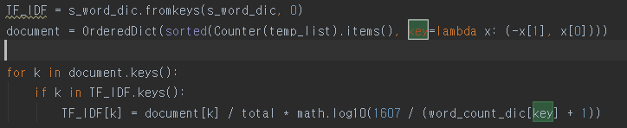
Data Mining
Implementation 2
Goal: Document(Vector) Representation with TF-IDF
Key code
Calculate TF-IDF
Sequence>>
Make word dictionary
Make document dictionary
Calculate TF-IDF

Slide 10
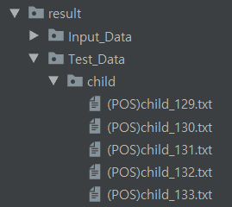
Data Mining
Implementation 2
Goal: Document(Vector) Representation with TF-IDF
(POS)child_119.txt
Make Input_Data, Test_Data, Val_Data
Output: TF-IDF Vector (about each categories)

Slide 11





Data Mining
Implementation 3
Goal: Learn Neural Network for news article category classification and check out prediction results
Sequence>>
Input File upload
(Filezilla)
Start server
(Putty)
Preprocessing
Check out
Prediction results

Slide 12
Data Mining
Implementation 3
Goal: Learn Neural Network for news article category classification and check out prediction results
Loss
Accuracy
: Need to optimized hyper parameters!

Slide 13
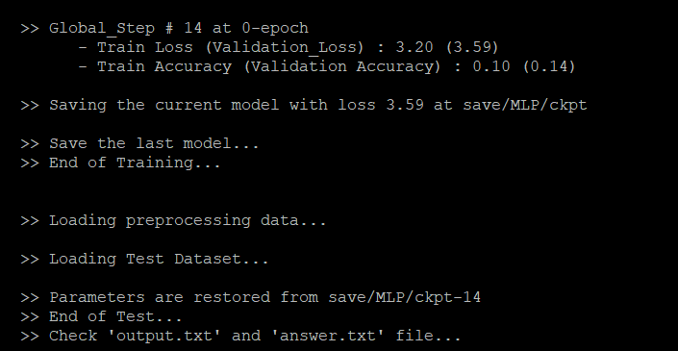
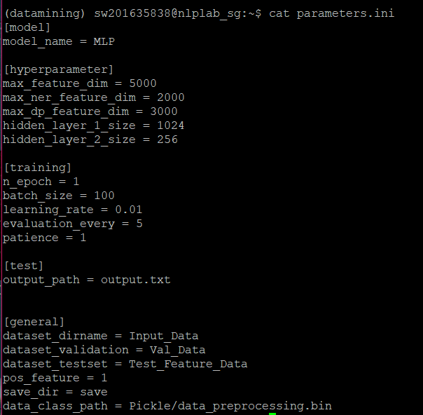
Data Mining
Implementation 3
Goal: Learn Neural Network for news article category classification and check out prediction results
High loss!!
Default hyper parameters
Validation loss : 3.59

Slide 14
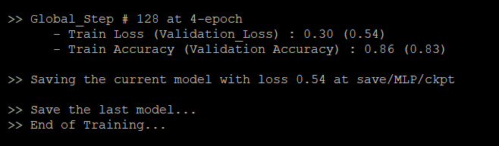
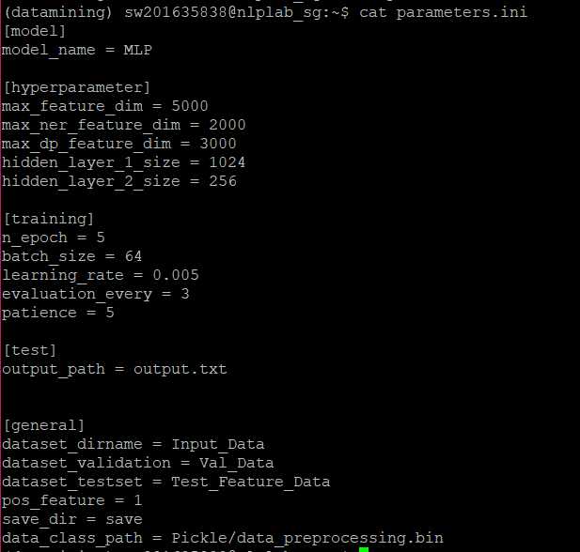
Data Mining
Implementation 3
Goal: Learn Neural Network for news article category classification and check out prediction results
Result >>
lower loss!!
changed hyper parameters
Validation loss : 0.54

Slide 15
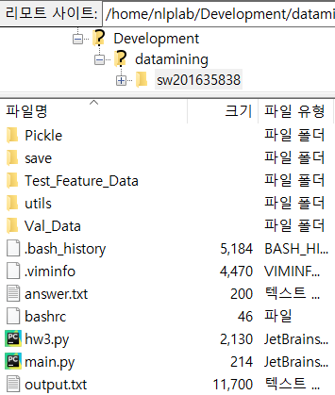
Data Mining
Implementation 3
Goal: Learn Neural Network for news article category classification and check out prediction results
Output
Output.txt & Answer.txt
Notes:
output.은 평가 데이터가 각각의 카테고리에 속할 것으로 모델이 예측된 확률값이,
Answer은 실제 정답 카테고리가 저장된다.

Slide 16
Data Mining
Implementation 4
Goal: Evaluation for Text Classification
Input
Output.txt & Answer.txt
Notes:
output.은 평가 데이터가 각각의 카테고리에 속할 것으로 모델이 예측된 확률값이,
Answer은 실제 정답 카테고리가 저장된다.

Slide 17
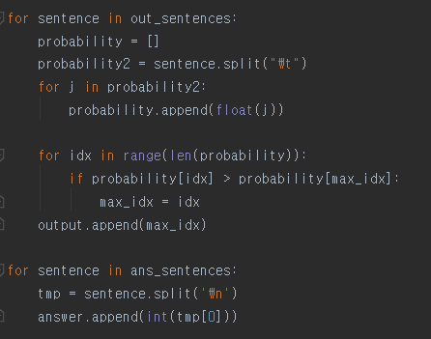
Data Mining
Implementation 4
Goal: Evaluation for Text Classification
Define the max index that have
max probability in output.txt each row
Key code

Slide 18
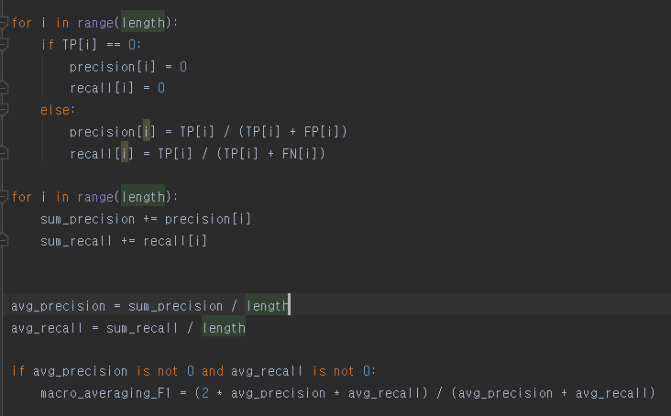
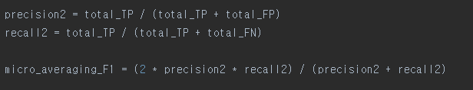
Data Mining
Implementation 4
Goal: Evaluation for Text Classification
Calculate micro_F1
Calculate macro_F1
Key code

Slide 19
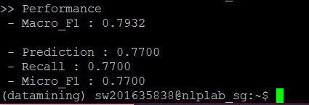
Data Mining
Implementation 4
Goal: Evaluation for Text Classification
Output
Macro_F1, Precision, recall, Micro_F1

Slide 20
Data Mining
Text Classification with Tensorflow
Thank You!
201635838 이예지

